Slide 1
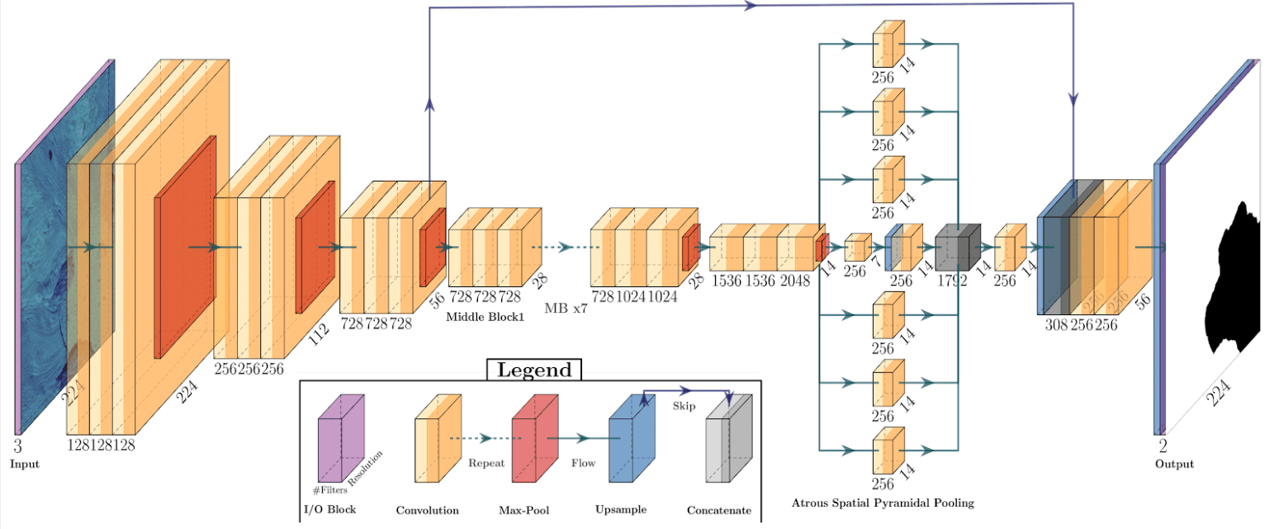

Convolutional Neural Networks
Slides adapted from:
CS231N: Fei Li, Andrej Karpathy & Justin Johnson
MIT6874: Dana Erlich, Param Vir Singh, David Gifford, Alexander Amini, Ava Soleimany
Daniel Cheng

Slide 2
Outline
Part 1
Classical machine vision foundations
Convolutional Neural Networks (CNN) Foundations
CNN Architectures
Part 2
Training CNNs
Understanding and Visualizing CNNs
Part 3
Applications

Slide 3
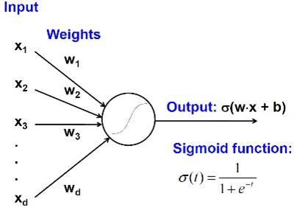
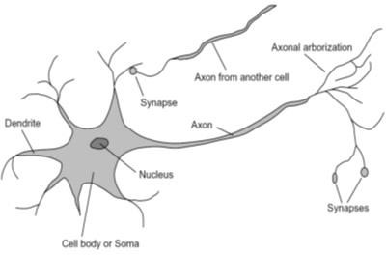
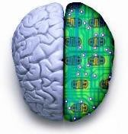
Biological neuron and Perceptrons
A biological neuron
An artificial neuron (Perceptron)
- a linear classifier

Slide 4
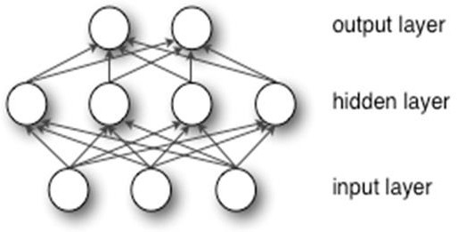
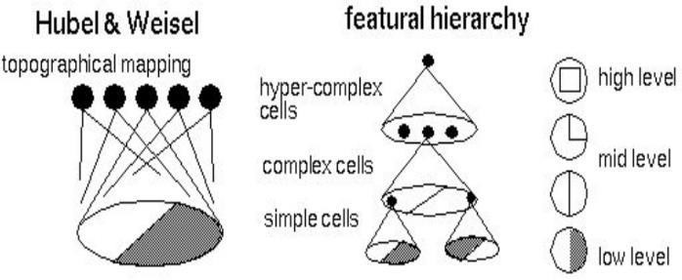
Biologically Inspired Multi-layer Perceptrons
Biological Inspiration & Architecture
Multi-layer Perceptron
- A non-linear classifier

Slide 5

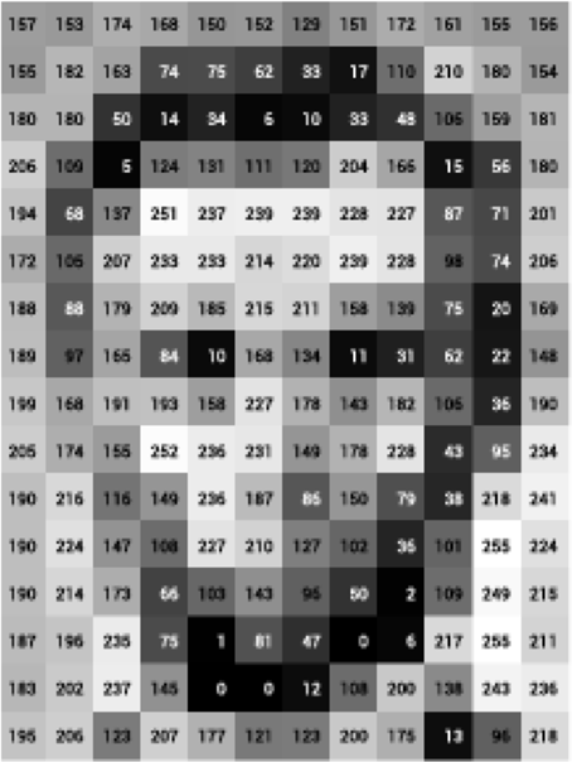
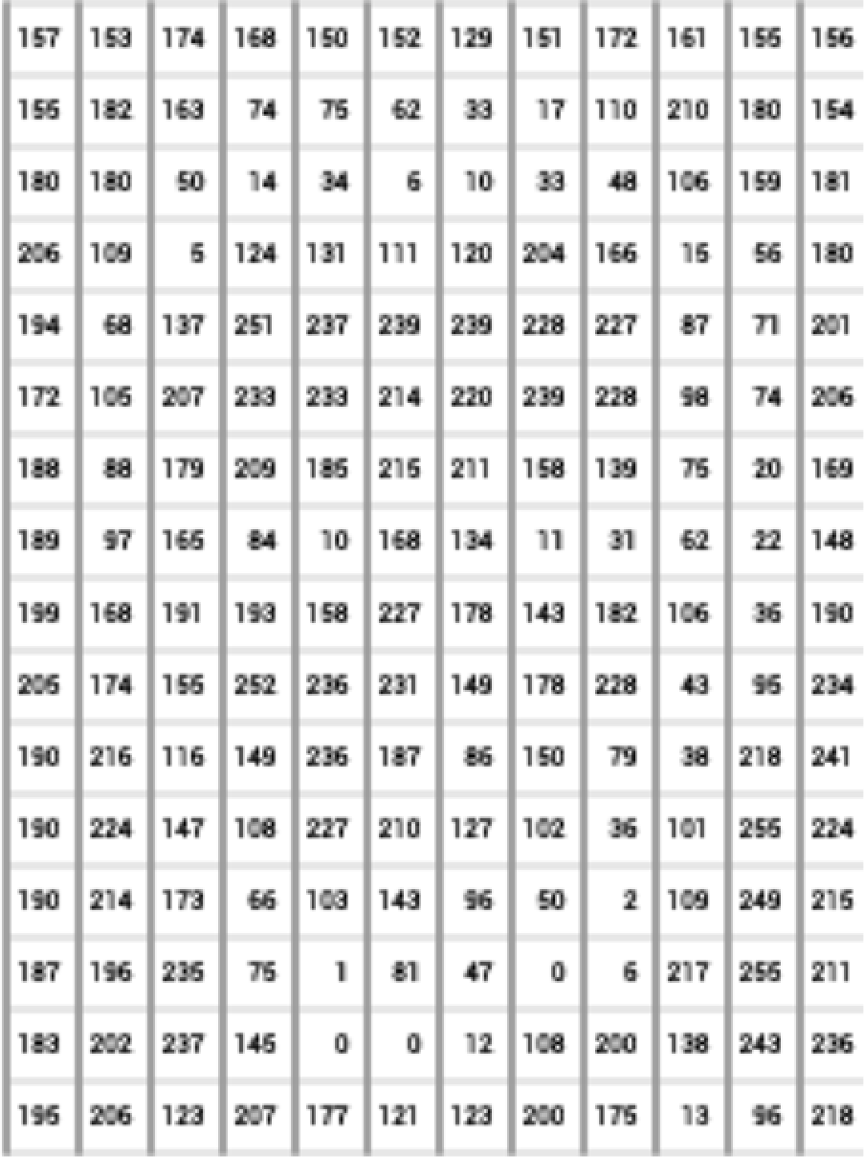
What computers ‘see’: Images as Numbers
What you see What you both see What the computer "sees"
Levin Image Processing & Computer Vision
Input Image Input Image + values
Pixel intensity values (“pix-el”=picture-element)
An image is just a matrix of numbers [0,255]. i.e., 1080x1080x3 for an RGB image.
Question: is this Lincoln? Washington? Jefferson? Obama?
MLPs/NNs allow the computer to perceive not just numbers, but features

Slide 6
Learning a Hierarchy of Feature Extractors
Classical computer vision techniques such as edge detection, Support Vector Machines (SVMs)/K-nearest neighbors (KNNs), and texture analysis filters require expert knowledge
Key Innovation: CNNs and ML allow the network training to automatically learn the features
Layer 1
Layer 2
Layer 3

Slide 7
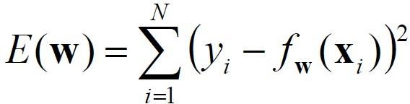
Multi-layer Perceptrons, or Neural Networks
Also known as MLPs, NNs, Artificial Neural Networks (ANNs)
Training: find network weights w to minimize the error between true training labels 𝑦_{𝑖} and estimated labels 𝑓_{𝒘} (𝒙_{𝒊} )
Minimization can be done by gradient descent provided 𝑓 is differentiable
This training method is called
back-propagation

Slide 8
Convolutional Neural Networks
Also known as CNNs, ConvNets
Subset of NNs with the following features:
Local connectivity
Weight sharing
Typically, handle multiple input channels

Slide 9
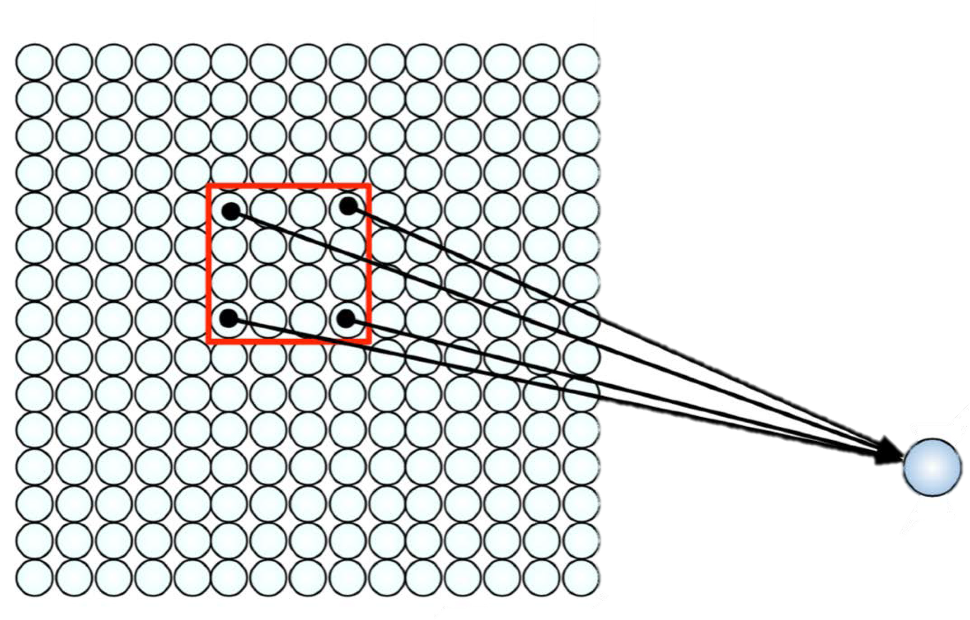
CNN: Local Connectivity
Hidden layer
Input layer
Global connectivity
Local connectivity
# input units (neurons): 7
# hidden units: 3
Number of parameters
Global connectivity: 3 x 7 = 21
Local connectivity: 3 x 3 = 9

Slide 10
CNN: Weight Sharing
Hidden layer
w₁ w₃
w₂
w₅ w₇ w₉ ^{w}4 ^{w}6 w₈
w₁
^{w}3 w₂ w₁ w₃ ^{w}2 w₁ w₃ w₂
Input layer
Without weight sharing
With weight sharing
# input units (neurons): 7
# hidden units: 3
Number of parameters
Without weight sharing: 3 x 3 = 9
With weight sharing : 3 x 1 = 3

Slide 11
CNN with multiple input channels
Hidden layer
Input layer
Channel 1
Channel 2
Single input channel
Multiple input channels
Filter weights
Filter weights

Slide 12
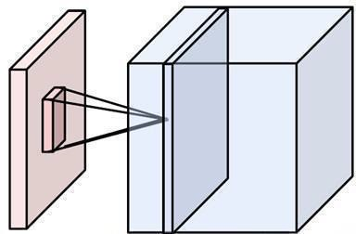
Putting them together
Local connectivity
Weight sharing
Handling multiple input channels
Weight sharing
Local connectivity
# input channels
# output (activation) maps
Image credit: A. Karpathy

Slide 13
CNN Architecture
Now, how to assemble a simple CNN?
Let’s begin single Convolutional layer

Slide 14
Convolution Layer
32x32x3 image
32
height
32
depth
width
3

Slide 15
Convolution Layer
32x32x3 image
5x5x3 filter
32
Convolve the filter with the image
i.e. “slide over the image spatially, computing dot products”
32
3

Slide 16
Convolution Layer
Filters always extend the full depth of the input volume
32x32x3 image
5x5x3 filter
32
Convolve the filter with the image
i.e. “slide over the image spatially, computing dot products”
32
3

Slide 17
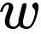
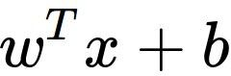
Convolution Layer
32x32x3 image 5x5x3 filter
32
1 number:
the result of taking a dot product between the filter and a small 5x5x3 chunk of the image (i.e. 5*5*3 = 75-dimensional dot product + bias)
32
3

Slide 18
Convolution Layer
activation map
32x32x3 image 5x5x3 filter
32
28
convolve (slide) over all spatial locations
32
28
3
1

Slide 19
CNN Architecture
We can create a single Convolutional layer
Let’s stack them together to get multiple feature/activation maps

Slide 20
consider a second, green filter
Convolution Layer
32x32x3 image 5x5x3 filter
activation maps
32
28
convolve (slide) over all spatial locations
32
28
3
1

Slide 21
For example, if we had 6 5x5 filters, we’ll get 6 separate activation maps:
Convolution Layer
activation maps
32
28
Convolution Layer
32
28
3
6
We stack these up to get a “new image” of size 28x28x6!

Slide 22
Note: CNNs are a sequence of Convolution Layers, interspersed with activation functions
Convolution Layer
32
28
CONV, ReLU
e.g. 6 5x5x3 filters
32
28
3
6

Slide 23
Convolution Layer
Note: CNNs are a sequence of Convolution Layers, interspersed with activation functions
32
28
24
….
CONV, ReLU
e.g. 6 5x5x3 filters
CONV, ReLU
e.g. 10 5x5x6 filters
CONV, ReLU
32
28
24
3
6
10

Slide 24
CNN Architecture
We can get multiple feature/activation maps from previous layers
What do those features look like?

Slide 25
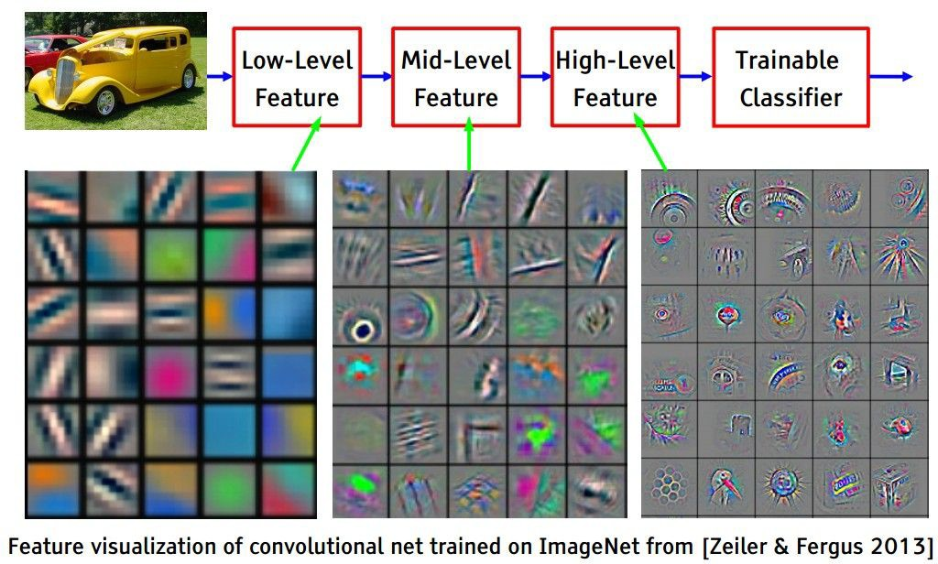
[From recent Yann LeCun slides]

Slide 26
CNN Architecture
We can get simple features (lines, edges) from our input layers
What do 2nd order features (from additional convolutional layer stacks) look like?

Slide 27
[From recent Yann LeCun slides]

Slide 28
CNN Architecture
We can get more complex features (shapes, corners, crosses) from our input layers
What do higher order features (from additional convolutional layer stacks) look like?

Slide 29
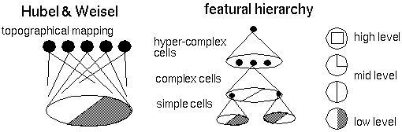
[From recent Yann LeCun slides]

Slide 30
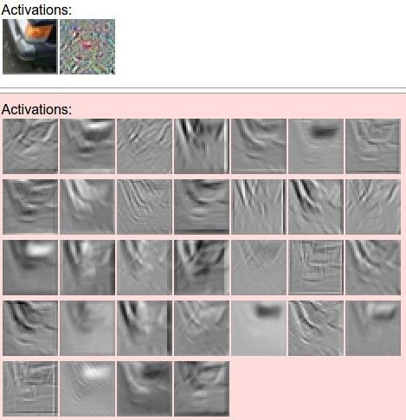
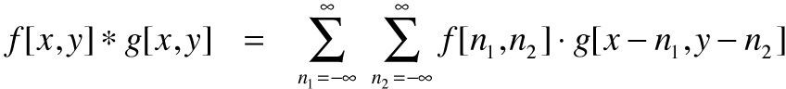
one filter =>
one activation map
example 5x5 filters
(32 total)
We call the layer convolutional because it is related to convolution of two signals:
elementwise multiplication and sum of a filter and the signal (image)

Slide 31

Real-world example: Object Classifcation

Slide 32
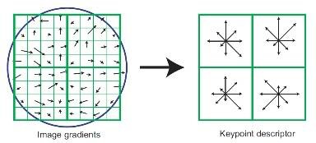
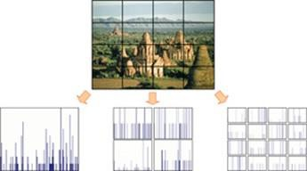
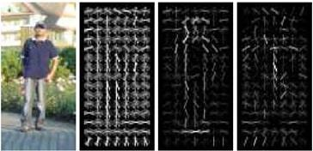
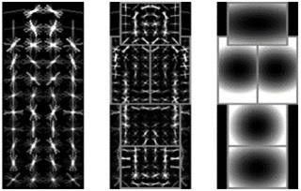
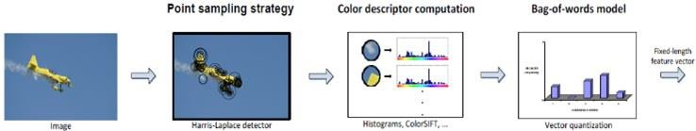
Context: Classical Computer Vision Features
SIFT [Loewe IJCV 04]
HOG [Dalal and Triggs CVPR 05]
SPM [Lazebnik et al. CVPR 06]
Color Descriptor [Van De Sande et al. PAMI 10]
DPM [Felzenszwalb et al. PAMI 10]

Slide 33
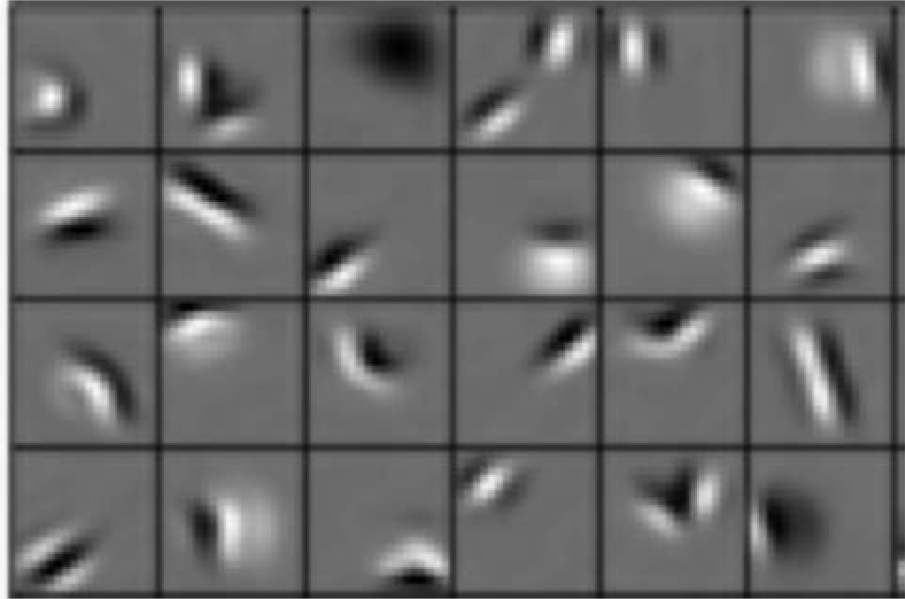
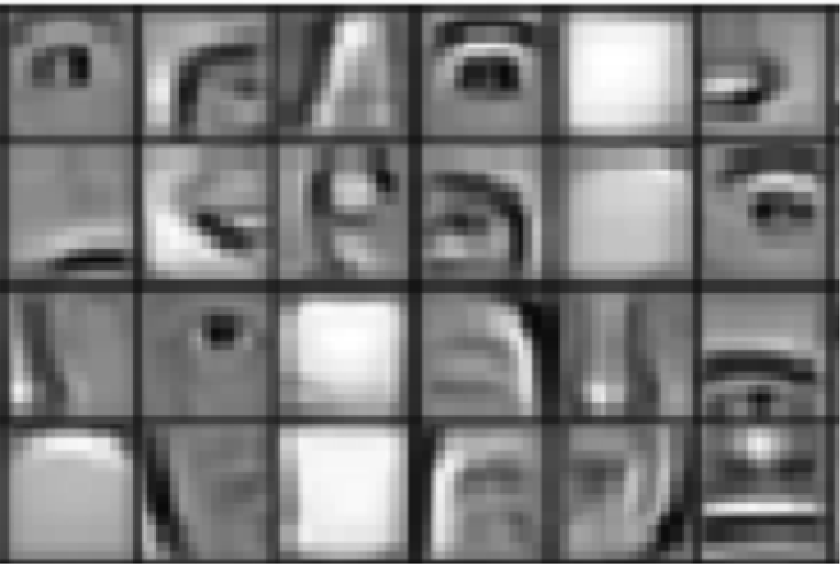
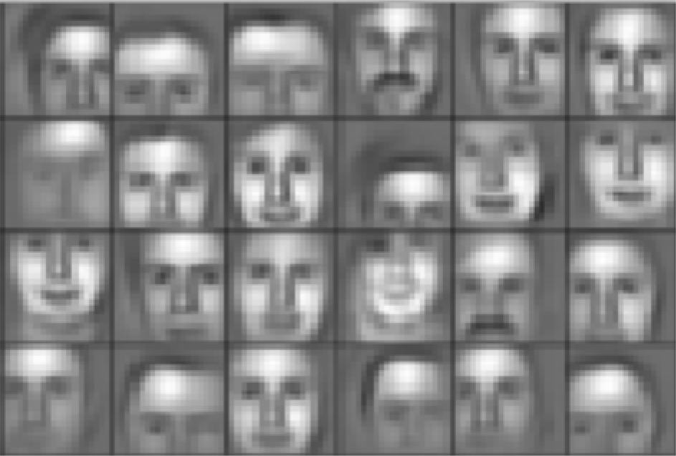
Key idea:
Learn hierarchy of features directly from the data
Context: CNN Features
Low level features
Mid level features
High level features
Edges, dark spots
Eyes, ears,nose
Facial structure
Lee+ ICML 2009

Slide 34
CNN Architecture
We can get very complex features (textures, faces, objects) from our layers
How do we balance the increasing layer complexity computationally?

Slide 35
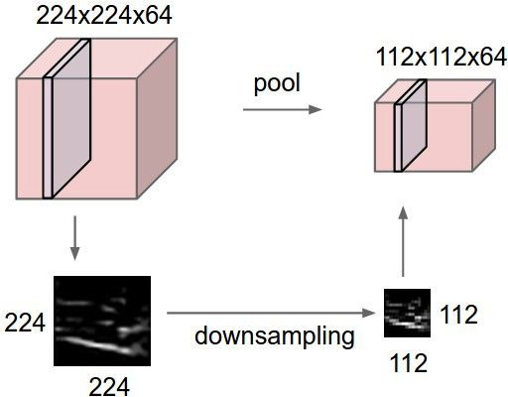
Pooling layer
Makes the representations smaller and more manageable
Operates over each activation map independently:

Slide 36
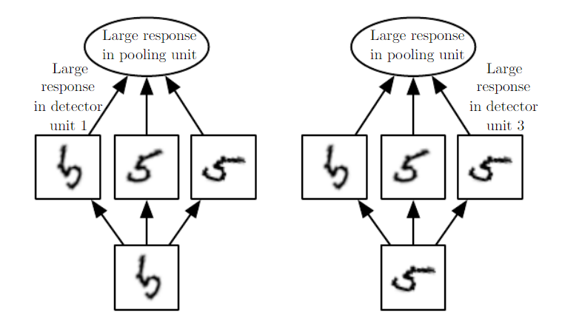
Pooling layer
Max pooling is most common pooling operation
Allows for “OR”/”any” detection behavior and learned invariances (i.e., rotation invariance)
Single depth slice
1 | 1 | 2 | 4
5 | 6 | 7 | 8
3 | 2 | 1 | 0
1 | 2 | 3 | 4
x
max pool with 2x2 filters and stride 2
6 | 8
3 | 4
y

Slide 37
CNN Architecture
We have many higher order features.
How do we classify them?

Slide 38
Fully Connected Layer (FC layer)
Contains neurons that connect to the entire input volume, as in ordinary NNs
Typically used as final or last stage classifications (expensive to use throughout)
Spatial Pooling used in conjunction to aid in scale invariant classification
Classifier Score
Dog | Cat | Glacier
0.1 | 0.2 | 0.9
High Level Features
Fur | Face | Icy | Cold | Ugly | Color | Ugly
0.1 | 0.2 | 0.9 | 1.0 | 0.2 | 0.2 | 0.5

Slide 39
CNN Architecture
We have many pixel-wise classifications.
How do we upscale them to their original resolutions?

Slide 40
Upsampling + Residual Connections
Reverse of pooling layer using bilinear interpolation (or similar)
Residual connections from earlier in the CNNs aid with class localization
Residuals also reduce vanishing gradients in deep networks
FC layers can be used to aid in reconstruction, but are not required
Residual Connection
Upsampling

Slide 41
CNN Architecture
We now have an end-to-end pixel-wise CNN classifier architecture! ☺

Slide 42
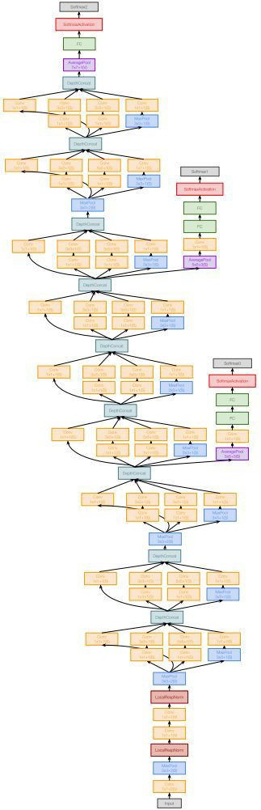
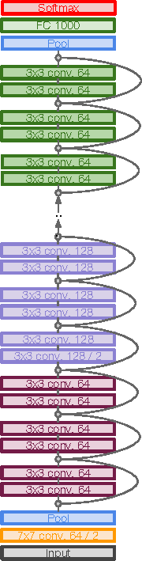
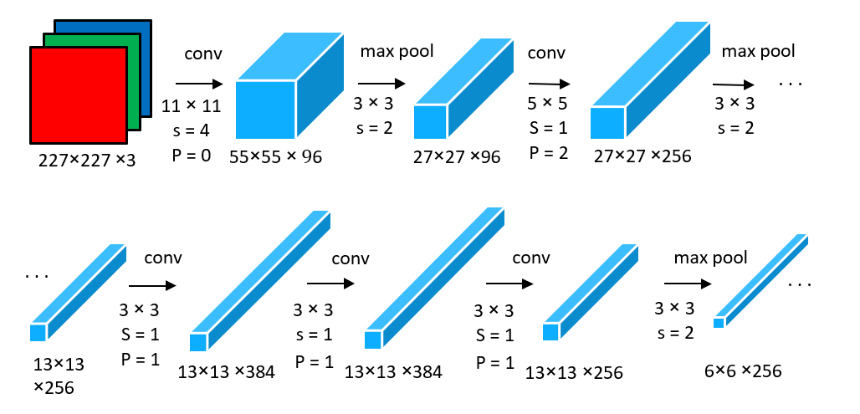
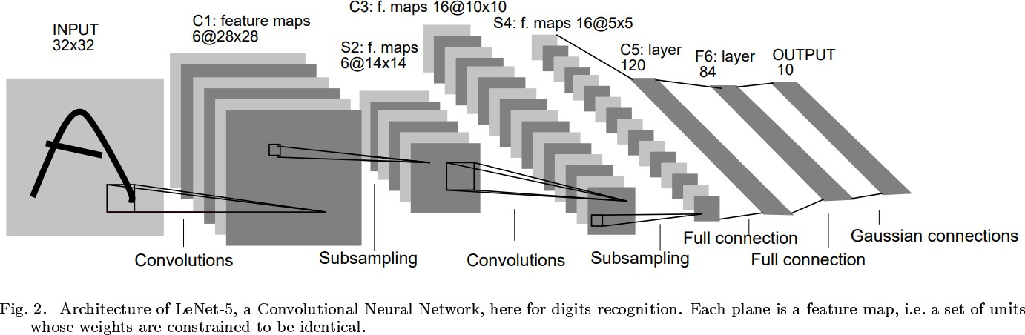
CNN Architectures
We’ve learned 1 CNN architecture, but what about other CNN architectures, specifically, the feature extractor arhcitectures?
What are their pros/cons for specific use cases?

Slide 43
LeNet-5
Gradient Based Learning Applied To Document Recognition -
Y. Lecun, L. Bottou, Y. Bengio, P. Haffner; 1998
Helped establish how we use CNNs today
Replaced manual feature extraction
[LeCun et al., 1998]

Slide 44
ResNet
ILSVRC’15 classification winner (3.57% top 5 error, humans generally hover around a 5- 10% error rate)
Makes use of/popularized Residual connections to enable deep neural networks and reduce vanishing gradient problem
Slide taken from Fei-Fei & Justin Johnson & Serena Yeung. Lecture 9.
[He et al., 2015]

Slide 45
GoogleNet
22 layers
Efficient “Inception” module - strayed from the general approach of simply stacking conv and pooling layers on top of each other in a sequential structure
No FC layers
Only 5 million parameters!
ILSVRC’14 classification winner (6.7% top 5 error)
[Szegedy et al., 2014]

Slide 46
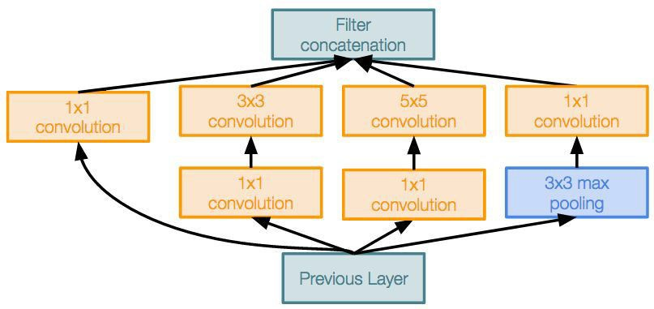
GoogleNet
“Inception module”: design a good local network topology (network within a network) and then stack these modules on top of each other
Filter
concatenation
1x1
convolution
3x3
convolution
5x5
convolution
1x1
convolution
1x1
convolution
1x1
convolution
3x3 max
pooling
Previous layer
Slide taken from Fei-Fei & Justin Johnson & Serena Yeung. Lecture 9.
[Szegedy et al., 2014]

Slide 47
UNet Family
Well established and useful architecture
Can use any feature extractor “head”, and outputs classifications per pixel

Slide 48
Outline
Part 1
Classical machine vision foundations
Convolutional Neural Networks (CNN) Foundations
CNN Architectures
Part 2
Training CNNs
Understanding and Visualizing CNNs
Part 3
Applications

Slide 49
Training Neural Networks
We have architectures!
How do we train them?
Training (& Testing) Workflow
Backpropagation + stochastic gradient descent with momentum
Neural Networks: Tricks of the Trade
Dropout
Data augmentation
Batch normalization
Initialization
Transfer learning

Slide 50
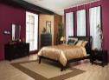
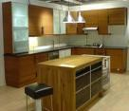
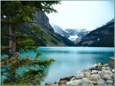
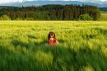
Training Workflow
Training Images
Training
Training Labels
Image Features
Classifier Training
Trained Classifier

Slide 51
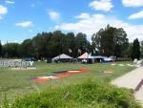
Training (& Testing) Workflow
Training Images
Training
Training Labels
Image Features
Classifier Training
Trained Classifier
Testing
Image Features
Prediction
Outdoor
Trained Classifier
Test Image

Slide 52
Training (& Testing) Workflow
Testing ensures we are not overfitting on the training data/ learned function
i.e., ensure we can generalize to new unseen data
Testing is usually also done during training
This is called validation, and is performed on 10-20% of reserved training data to ensure generalization while training
Testing
Image Features
Prediction
Outdoor
Trained Classifier
Test Image

Slide 53
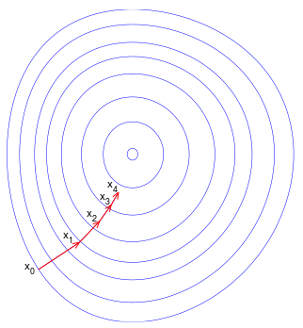
Training CNN with gradient descent
A CNN as composition of functions
𝑓_{𝒘} 𝒙 = 𝑓_{𝐿}(… (𝑓₂ 𝑓₁ 𝒙; 𝒘₁ ; 𝒘₂ … ; 𝒘_{𝐿})
Parameters
𝒘 = (𝒘_{𝟏}, 𝒘_{𝟐}, … 𝒘_{𝑳})
Empirical loss function
1
𝐿 𝒘
= ෍ 𝑙(𝑧_{𝑖}, 𝑓_{𝒘}(𝒙_{𝒊}))
𝑛
𝑖
Gradient descent (w/ optimizers such as Adam)
𝜕𝒇
_{𝒘}𝒕+𝟏 _{= 𝒘}𝒕
𝒕
− 𝜂
(𝒘 )
New weight
𝑡
𝜕𝒘
Old weight
Learning rate
Gradient

Slide 54
An Illustrative example
𝜕𝑓
𝜕𝑓
𝑓 𝑥, 𝑦 = 𝑥𝑦,
= 𝑦,
= 𝑥
𝜕𝑥
𝜕𝑦
Example:
𝑥 = 4, 𝑦 = −3 ⇒ 𝑓 𝑥, 𝑦 = −12
Gradient
𝛻𝑓 = [
Partial derivatives
𝜕𝑓
= −3,
𝜕𝑥
𝜕𝑓
𝜕𝑦
𝜕𝑓 𝜕𝑓
𝜕𝑥 𝜕𝑦
= 4
, ]
Example credit: Andrej Karpathy

Slide 55
𝑓(𝑥, 𝑦, 𝑧) = (𝑥 + 𝑦) 𝑧 = 𝑞𝑧
𝑞 = 𝑥 + 𝑦
𝜕𝑞
𝑓 = 𝑞𝑧
𝜕𝑓
𝜕𝑞
= 1
𝜕𝑦
𝜕𝑓
= 𝑞
𝜕𝑧
= 1,
= 𝑧,
𝜕𝑥
𝜕𝑞
Goal: compute the gradient
𝜕𝑓 𝜕𝑓 𝜕𝑓
𝛻𝑓 = [ , , ]
𝜕𝑥 𝜕𝑦 𝜕𝑧
Example credit: Andrej Karpathy

Slide 56
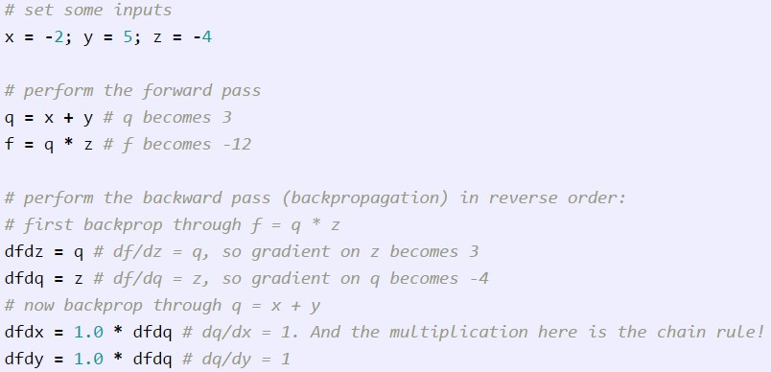
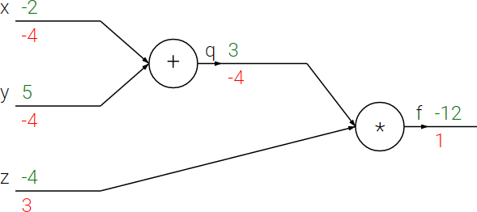
𝑓(𝑥, 𝑦, 𝑧) = (𝑥 + 𝑦) 𝑧 = 𝑞𝑧
𝑞 = 𝑥 + 𝑦
𝜕𝑞
𝑓 = 𝑞𝑧
𝜕𝑓
𝜕𝑞
= 1
𝜕𝑦
𝜕𝑓
= 𝑞
𝜕𝑧
= 1,
= 𝑧,
𝜕𝑥
𝜕𝑞
Chain rule:
𝜕𝑓 𝜕𝑓 𝜕𝑞
=
𝜕𝑥 𝜕𝑞 𝜕𝑥
Example credit: Andrej Karpathy

Slide 57


Backpropagation (recursive chain rule)
𝑤₁
𝑤₂
𝑞
𝜕𝑓
𝜕𝑞
𝜕𝑞 𝜕𝑓
𝑤_{𝑛}
𝜕𝑓
=
𝜕𝑤_{𝑖} 𝜕𝑤_{𝑖} 𝜕𝑞
Local gradient
Gate gradient
Can be computed during forward pass The gate receives this during backprop

Slide 58
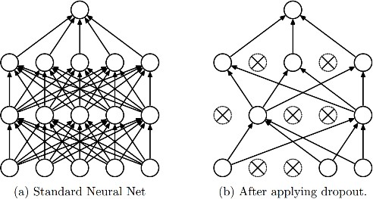
Dropout
Dropout: A simple way to prevent neural networks from overfitting [Srivastava JMLR 2014]
Intuition: successful conspiracies
50 people planning a conspiracy
Strategy A: plan a big conspiracy involving 50 people
Likely to fail. 50 people need to play their parts correctly.
Strategy B: plan 10 conspiracies each involving 5 people
Likely to succeed!

Slide 59
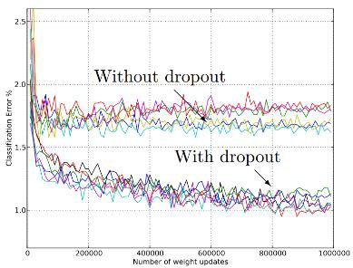
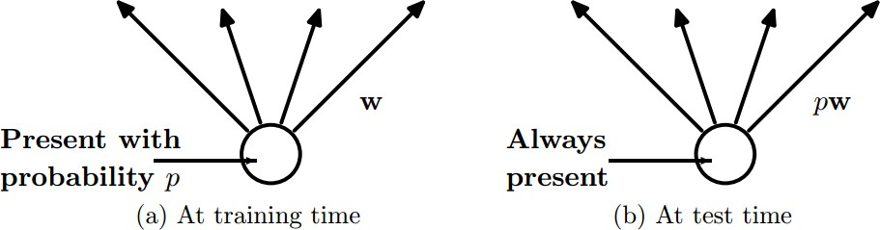
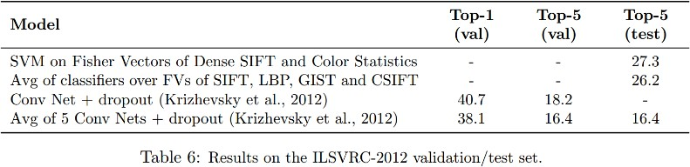
Dropout
Main Idea: approximately combining exponentially many different neural network architectures efficiently
Dropout: A simple way to prevent neural networks from overfitting [Srivastava JMLR 2014]

Slide 60
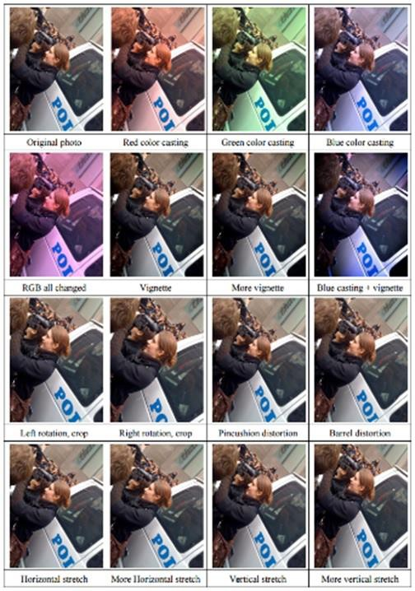
Data Augmentation
Manually created training data is expensive/overfitting
Create virtual training samples
Horizontal flip
Random crop
Color casting
Contrast/Brightness enhancement
Geometric distortion*
Deep Image [Wu et al. 2015]

Slide 61
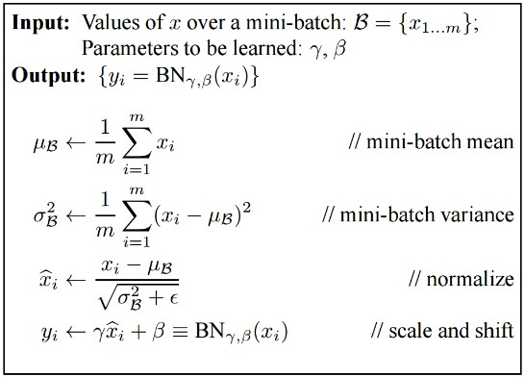
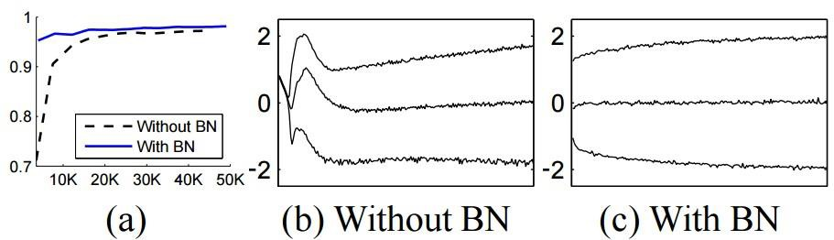
Batch Normalization
Main Idea: Allow for stochastic gradient descent within computational limits, since most GPUs can handle more than one but less than all of the training data (i.e., m ~= 2-32)
Batch Normalization: Accelerating Deep Network Training by Reducing Internal Covariate Shift [Ioffe and Szegedy 2015]

Slide 62
Understanding and Visualizing CNNs
We’ve trained our CNN
How do we know what’s going on inside?
Find images that maximize some class scores
Individual neuron activation

Slide 63
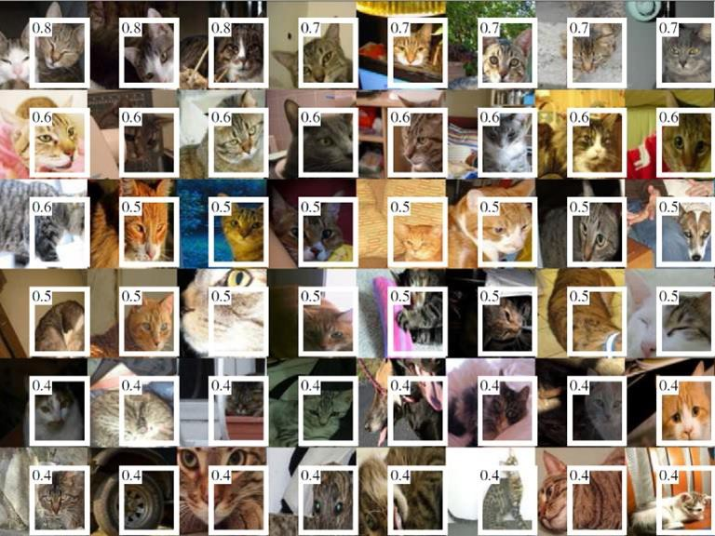
Individual Neuron Activation
RCNN [Girshick et al. CVPR 2014]

Slide 64
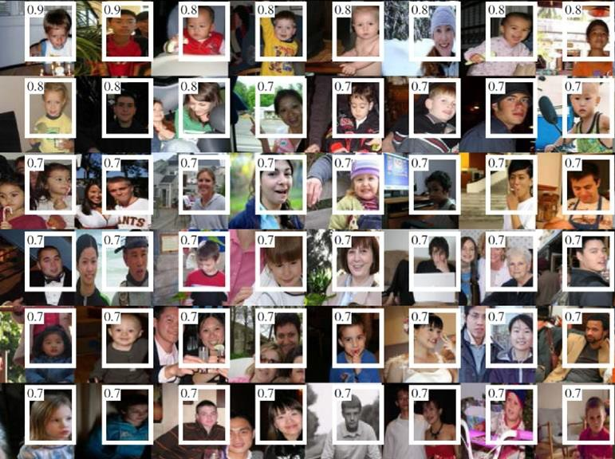
Individual Neuron Activation
RCNN [Girshick et al. CVPR 2014]

Slide 65
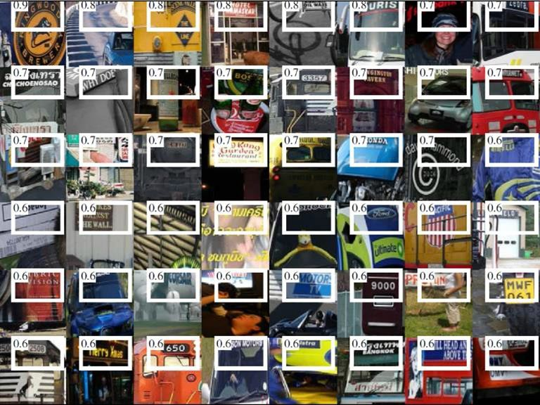
Individual Neuron Activation
RCNN [Girshick et al. CVPR 2014]

Slide 66

Map activation back to the input pixel space
What input pattern originally caused a given activation in the feature maps?
Visualizing and Understanding Convolutional Networks [Zeiler and Fergus, ECCV 2014]

Slide 67

Layer 1
Visualizing and Understanding Convolutional Networks [Zeiler and Fergus, ECCV 2014]

Slide 68

Layer 2
Visualizing and Understanding Convolutional Networks [Zeiler and Fergus, ECCV 2014]

Slide 69

Layer 3
Visualizing and Understanding Convolutional Networks [Zeiler and Fergus, ECCV 2014]

Slide 70

Layer 4 and 5
Visualizing and Understanding Convolutional Networks [Zeiler and Fergus, ECCV 2014]

Slide 71


Network Dissection
http://netdissect.csail.mit.edu/

Slide 72
Things to remember
Convolutional neural networks
A cascade of conv + ReLU + pool
Automatic feature learning
Numerous architectures
Tricks for training CNNs
Visualizing CNNs
Activation mapping
Dissection

Slide 73
Resources
http://deeplearning.net/
Hub to many other deep learning resources
https://github.com/ChristosChristofidis/awesome-deep- learning
A resource collection deep learning
https://github.com/kjw0612/awesome-deep-vision
A resource collection deep learning for computer vision
http://cs231n.stanford.edu/syllabus.html
Nice course on CNN for visual recognition

Slide 74
Additional Slides Implementation Details/Errata

Slide 75
A closer look at spatial dimensions:
activation map
32x32x3 image 5x5x3 filter
32
28
convolve (slide) over all spatial locations
32
28
3
1

Slide 76
A closer look at spatial dimensions:
7
7x7 input (spatially) assume 3x3 filter
7

Slide 77
A closer look at spatial dimensions:
7
7x7 input (spatially) assume 3x3 filter
7

Slide 78
A closer look at spatial dimensions:
7
7x7 input (spatially) assume 3x3 filter
7

Slide 79
A closer look at spatial dimensions:
7
7x7 input (spatially) assume 3x3 filter
7

Slide 80
A closer look at spatial dimensions:
7
7x7 input (spatially) assume 3x3 filter
=> 5x5 output
7

Slide 81
A closer look at spatial dimensions:
7
7x7 input (spatially) assume 3x3 filter applied with stride 2
7

Slide 82
A closer look at spatial dimensions:
7
7x7 input (spatially) assume 3x3 filter applied with stride 2
7

Slide 83
A closer look at spatial dimensions:
7
7x7 input (spatially) assume 3x3 filter applied with stride 2
=> 3x3 output!
7

Slide 84
A closer look at spatial dimensions:
7
7x7 input (spatially) assume 3x3 filter applied with stride 3?
7

Slide 85
A closer look at spatial dimensions:
7
7x7 input (spatially) assume 3x3 filter applied with stride 3?
7
doesn’t fit!
cannot apply 3x3 filter on 7x7 input with stride 3.

Slide 86
N
Output size:
(N - F) / stride + 1
 |  |  | F
 | F
e.g. N = 7, F = 3:
stride 1 => (7 - 3)/1 + 1 = 5
stride 2 => (7 - 3)/2 + 1 = 3
stride 3 => (7 - 3)/3 + 1 = 2.33 ☹
N

Slide 87
Remember back to…
E.g. 32x32 input convolved repeatedly with 5x5 filters shrinks volumes spatially! (32 -> 28 -> 24 ...). Shrinking too fast is not good, doesn’t work well.
32
28
24
….
CONV, ReLU
e.g. 6 5x5x3 filters
CONV, ReLU
e.g. 10 5x5x6 filters
CONV, ReLU
32
28
24
3
6
10

Slide 88
In practice: Common to zero pad the border
0 | 0 | 0 | 0 | 0 | 0
0
0
0
0
e.g. input 7x7
3x3 filter, applied with stride 1
pad with 1 pixel border => what is the output?
(recall:)
(N - F) / stride + 1

Slide 89
In practice: Common to zero pad the border
0 | 0 | 0 | 0 | 0 | 0
0
0
0
0
e.g. input 7x7
3x3 filter, applied with stride 1
pad with 1 pixel border => what is the output?
7x7 output!

Slide 90
In practice: Common to zero pad the border
0 | 0 | 0 | 0 | 0 | 0
0
0
0
0
e.g. input 7x7
3x3 filter, applied with stride 1
pad with 1 pixel border => what is the output?
7x7 output!
in general, common to see CONV layers with stride 1, filters of size FxF, and zero-padding with (F-1)/2. (will preserve size spatially)
e.g. F = 3 => zero pad with 1 F = 5 => zero pad with 2 F = 7 => zero pad with 3

Slide 91


Slide 92
Common settings:
K = (powers of 2, e.g. 32, 64, 128, 512)
- F = 3, S = 1, P = 1
- F = 5, S = 1, P = 2
- F = 5, S = 2, P = ? (whatever fits)
- F = 1, S = 1, P = 0

Slide 93
Example time:
Input volume: 32x32x3
10 5x5 filters with stride 1, pad 2
Output volume size: ?

Slide 94
Example time:
Input volume: 32x32x3
10 5x5 filters with stride 1, pad 2
Output volume size:
(32+2*2-5)/1+1 = 32 spatially, so
=> 32x32x10 = 10240

Slide 95
Example time:
Input volume: 32x32x3
10 5x5 filters with stride 1, pad 2
Number of parameters in this layer?

Slide 96
Example time:
Input volume: 32x32x3
10 5x5 filters with stride 1, pad 2
Number of parameters in this layer? each filter has 5*5*3 + 1 = 76 params
=> 76*10 = 760
(+1 for bias)

Slide 97


Example: CONV layer in Torch

Slide 98


Slide 99
Common settings:
F = 2, S = 2
F = 3, S = 2

